Slide 1
Gesture Induced Interactive System (G.I.I.S)
27th – October - 2013
A Project Presentation on :
Presented by
Vikas Singh 69
Nikhil Tarle 71
Sanjay Wadhwane 77
A VNS Tech solution
Software and Hardware Images/modules/samples shown are for illustrative purposes only and some of them are purely tentative at this stage. Final product may vary.

Slide 2
Introduction

Slide 3
Some Basic Questions
What are the currently used traditional input devices for a computer?
How “plain-Jane” are those methods of interaction?
What if something exciting, something more immersive way of interaction is devised?
What if something out of the box, some method that does not confine you in a small workspace and allows you to not only interact with your computer but also control multiple applications and games without keyboard and mouse?
What if all this is easy , portable, and “low cost” ?

Slide 4
And the Answers
Keyboards, mouse and some touchscreens
Indeed this type of interaction has been rock solid in terms of stability but is now showing its age in the recent trend of virtual interaction.

Slide 5
Gesture Induced Interactive System
This is where
Comes in
G.I.I.S is aimed at providing one such AIO solution for virtual interaction needs of not only a new way of computer application interaction but also gaming interaction.
The Main focus is “LOW COST”

Slide 6
How?
GIIS is built using a host of hardware devices software and custom made accessories
The majority of hardware are game consoles controllers
The controllers are interconnected by Bluetooth dongle > pc program > USB cables

Slide 7
Getting Closer to “Reality”

Slide 8
Aims and Objectives
This project mainly focuses on the universal scenarios of interacting with a computer
However, as functional as the keyboard and mouse may be, this day and age demands a much more intuitive and fun way of interaction.

Slide 9
Why GIIS?
Apart from the above stated features and functionalities, GIIS also adds in voice support.
As stated previously, the main focus is building a “low cost system”

Slide 10
Hardware and Software Overview
To form the Gesture Induced Interface…a number for devices, softwares are used which are made from ground up or readymade
Xbox Kinect
Wiimote
Microphone
IR Gloves
Programmer Software for the game controllers : GlovePIE
Other SDKS such as openNI may also be used.
The front end will be a mix Visual Studio and Swing

Slide 11
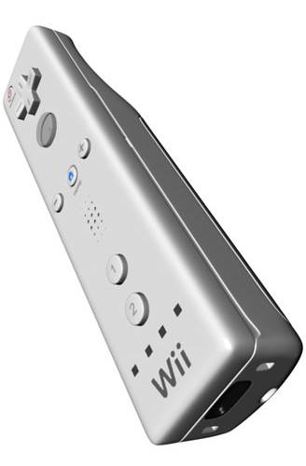
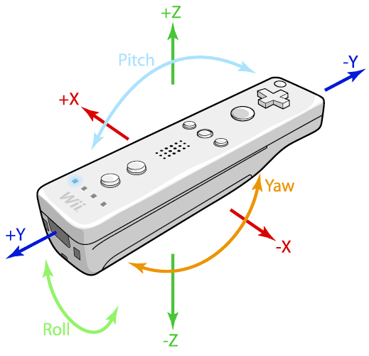
Wiimote
A main feature of the Wii Remote is its motion sensing capability, which allows the user to interact with and manipulate items on screen via gesture recognition and pointing through the use of accelerometer and optical sensor(IR Tracking).
Wiimote
Accelerometer in wiimote

Slide 12
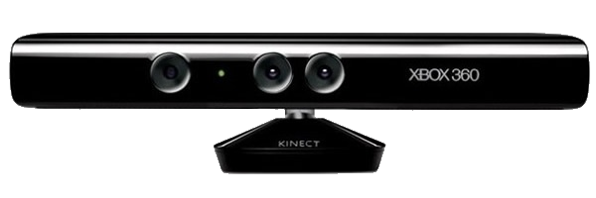
Kinect
Kinect | Array Specifications
Viewing angle | 43° vertical by 57° horizontal field of view
Vertical tilt range | ±27°
Frame rate (depth and color stream) | 30 frames per second (FPS)
Audio format | 16-kHz, 24-bit mono pulse code modulation (PCM)
Audio input characteristics | A four-microphone array with 24-bit analog-to-digital converter (ADC) and Kinect-resident signal processing including acoustic echo cancellation and noise suppression
Accelerometer characteristics | A 2G/4G/8G accelerometer configured for the 2G range, with a 1° accuracy upper limit.

Slide 13
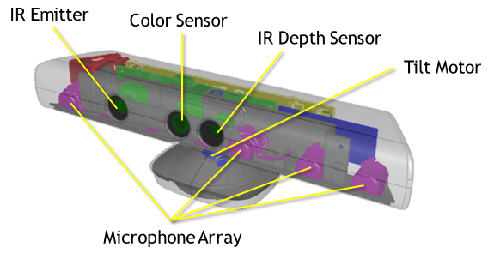
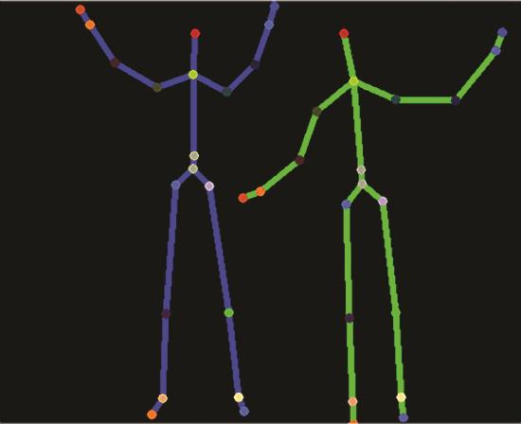
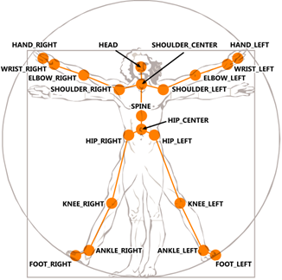

Slide 14
System Integration

Slide 15
Methodology
Object Oriented
Linear Programming
Abstraction
Modular Programming

Slide 16
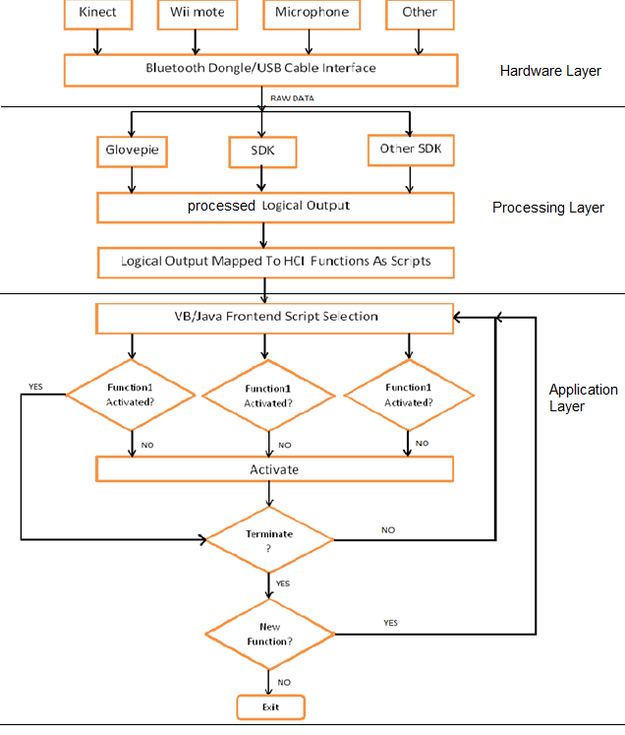
Architecture
Hardware Layer
Processing Layer
Application Layer

Slide 17
Concepts
IR Tracking: Finger Tracking
IR Tracking is the Tracking of movement of an IR light Source Used To Communicate with the PC.
This Is Done By The Wiimote IR Camera.

Slide 18
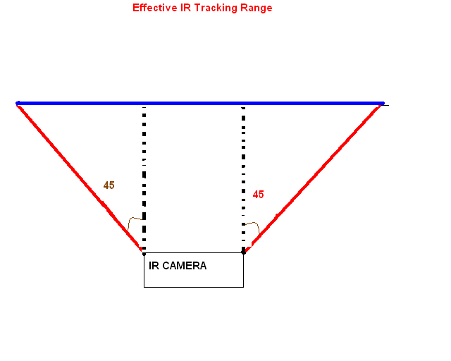
IR Finger Tracking
User’s fingers are tracked to emulate mouse functions
How this is Actually done is: the user would wear IR fitted customs gloves
Wiimote’s IR Tracking Range

Slide 19
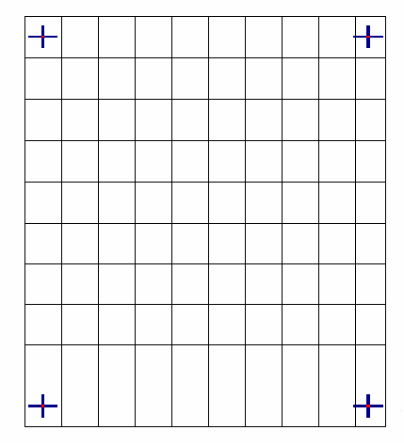
IR Touchscreen
Convert any project surface into a touchscreen
This Is Also Implemented By IR Tracking.
It is Similar to Finger Tracking in concept and design but different in working.
Touch Calibration Grid

Slide 20
Body Tracking
Using Kinect
Entire body tracking with depth and Tracking
Body Tracking : Kinect Output

Slide 21
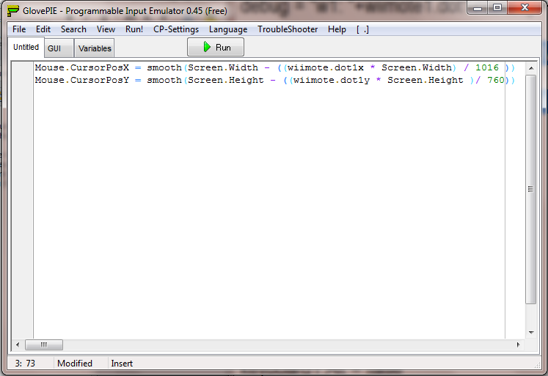
Sample

Slide 22
How does all this come together? Project Demo

Slide 23
THANK YOU
A VNS Tech solution
Software and Hardware Images/modules/samples shown are for illustrative purposes only and some of them are purely tentative at this stage. Final product may vary.

